Slide 1


Automobile insurance complaints ranking

Slide 2

Project Team ID: PTID-CDA-NOV-25-879 Project code : CDACL001 Project Name : Automobile Insurance Complaints Rankings Team members: B. Chandu P. Rajiv Revanth Y. Ashok Kumar

Slide 3
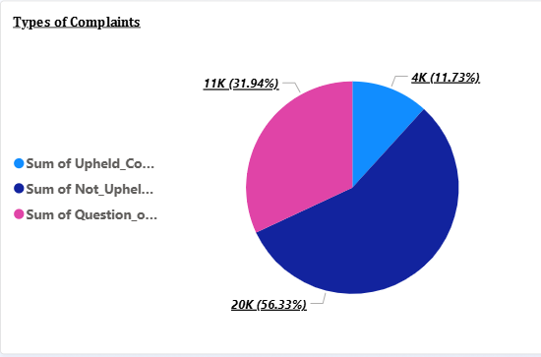
Analysing How Often Different Types Of Complaints Occur:
The data indicates that Not Upheld Complaints occur most frequently, with around 20,000, making them the largest complaint category. Question of Fact Complaints follow at approximately 11,000, showing a moderate level of disputes requiring clarification. Upheld Complaints are the least common, with only 4,000 cases, suggesting fewer instances where customer concerns are validated. Overall, the trend shows that most complaints do not result in an upheld decision.

Slide 4
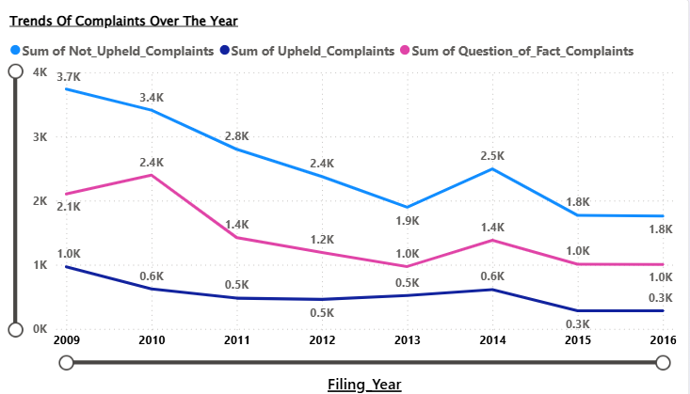
The Trends of Complaints Over The Years :
The visual shows a clear declining trend in all three types of complaints from 2009 to 2016. Not-upheld complaints start the highest at around 3.7K in 2009 and steadily drop to about 1.8K by 2016, though there is a slight rise in 2014. Question-of-fact complaints also decrease overall—from about 2.1K in 2009 to roughly 1K in 2016—with a small peak in 2010 and again in 2014. Upheld complaints remain the lowest category throughout the years, falling from around 1K in 2009 to approximately 0.3K by 2016. Overall, the chart indicates a consistent reduction in complaints across all categories over time.
.

Slide 5
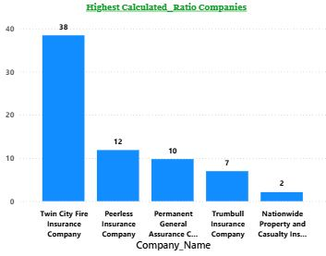
Suggesting a Company That Need Improvement To Reduce Complaint Ratio:
Based on the chart, Twin City Fire Insurance Company shows the highest calculated ratio of 38 when we look into all year’s data(2009-2016), indicating a significantly higher level of complaints relative to its premium scale. This elevated ratio suggests that the company may need to closely examine its customer service processes, claim-handling efficiency, and communication practices. Improving these areas could help reduce customer dissatisfaction and lower future complaint ratios. Focusing on policy transparency and faster resolution times may also contribute to better customer outcomes. Overall, the company stands out as a strong candidate for targeted improvement efforts.

Slide 6
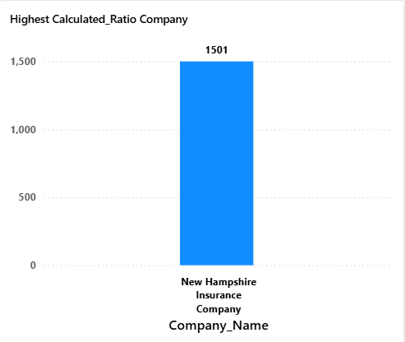
Suggesting a Company That Need Improvement To Reduce Complaint Ratio:
Based on the chart, New Hampshire Insurance Company shows the highest calculated ratio of 1501 with the given data (2009,2010,2014) indicating a significantly higher level of complaints relative to its scale. This elevated ratio suggests that the company may need to closely examine its customer service processes, claim-handling efficiency, and communication practices. Improving these areas could help reduce customer dissatisfaction and lower future complaint ratios. Focusing on policy transparency and faster resolution times may also contribute to better customer outcomes. Overall, the company stands out as a strong candidate for targeted improvement efforts.

Slide 7
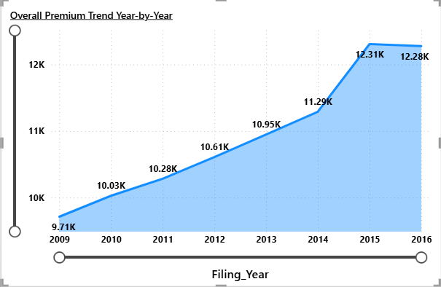
Plot Premium Amounts Year-by-Year To Visualize The Overall Trend:
The year-by-year premium trend shows a steady and consistent increase from 2009 to 2014. Premiums rise from 9.71K in 2009 to 11.29K in 2014, reflecting gradual growth in policy purchases or premium rates. A sharp jump occurs in 2015, reaching 12.31K, indicating a significant spike in premium collection for that year. In 2016, the premium slightly decreases to 12.28K, but still remains much higher than earlier years. Overall, the chart highlights strong upward momentum in premiums over the entire period.

Slide 8
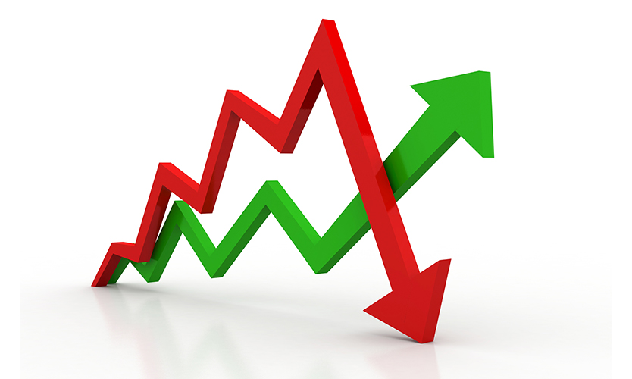
Causes Behind The Fluctuations In Premiums
Event though the data set doesn’t include all external factors , premium changes over the years can be explained by several influences:
Increase in claims activity-higher premiums more complaints or claims indicate higher risk and push premiums upward.
Regulatory changes authorities may require insurers to revise pricing structure.
Inflation & Rising Repair Costs Higher inflation or vehicle repair costs can lead to premium increases.
Market Competition Companies adjust premiums based on competitive pricing strategies.
Risk Profile of Insured Vehicles if a company starts covering high-risk vehicles , premium tend to increase.

Slide 9
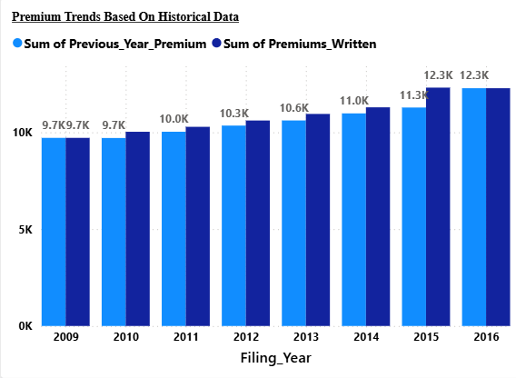
Providing Insights For Future Premium Trends Based On Historical Data And Identified Factors:
The historical data shows a steady rise in both previous-year premiums and premiums written, indicating continuous market expansion and strong customer retention. Premiums consistently increase each year, reaching their peak at 12.3K in 2015 and 2016, which suggests growing demand and possibly higher policy values. If this upward momentum continues, future premiums are likely to follow a similar growth pattern driven by factors such as increased policy renewals, broader coverage offerings, and market stability. The close alignment between the two premium measures also implies predictable and reliable revenue trends. Overall, the data points toward a positive future outlook, with premiums expected to gradually increase in the coming years.

Slide 10
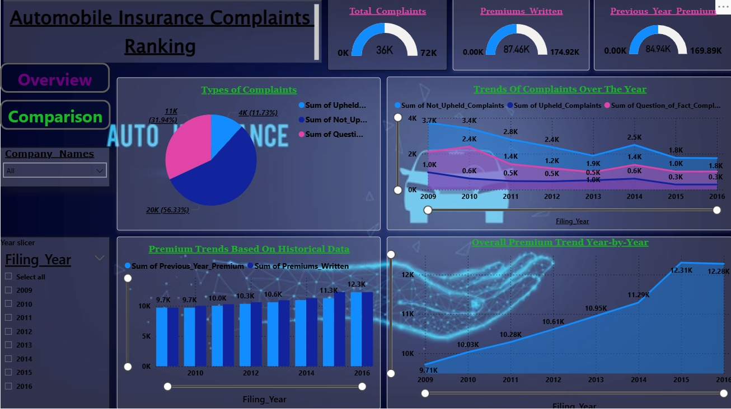
Overview:

Slide 11
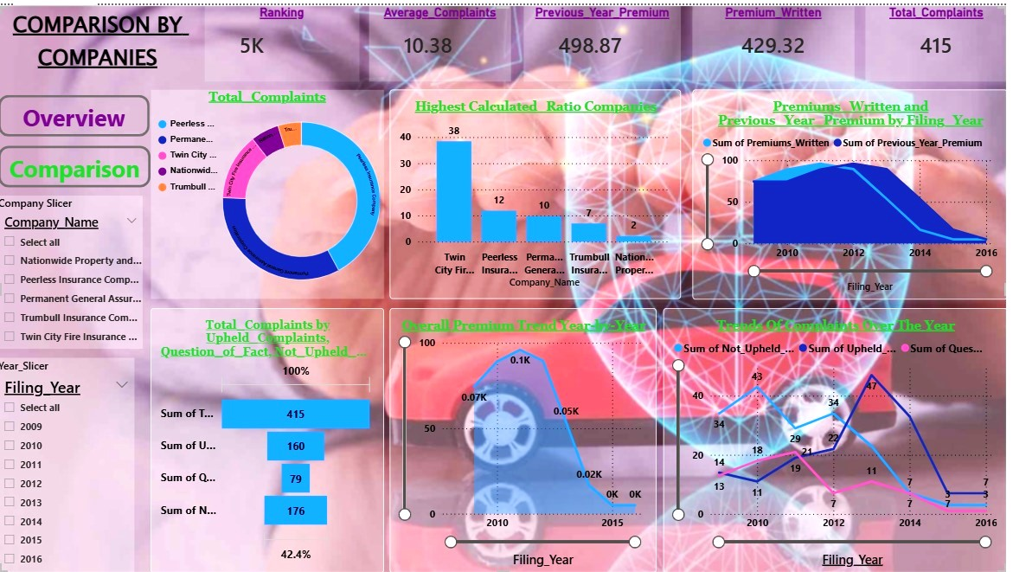
Comparison by Companies:

Slide 12

Thank you !

